Slide 1

HOSPITAL APPOINTMENT BOOKING SYSTEM
Submitted By - Saloni Sahani
Internship Course - Cloud Computing
Guided By - Ms. Monali Kumari

Slide 2
Introduction
This project is a CityCare Hospital Appointment Booking Website integrated with IBM watsonx Assistant Chatbot.
It allows patients to view hospital details, check departments and doctors, and book appointments online easily.
The integrated AI chatbot helps users by answering questions like hospital timings, services, and appointment booking. It provides quick and automatic support 24/7.
The main aim of this project is to make hospital services faster, easier, and more convenient for patients.

Slide 3
Problem Statement
In many hospitals:
Appointments are booked manually
Patients must call or visit physically
There is long waiting time
Staff workload is high
Information is not easily available
So I developed a digital solution where:
Appointments can be booked online
Patients get instant responses
AI chatbot provides 24/7 support
Manual work is reduced

Slide 4
Website Overview
Purpose: A smart hospital booking website that allows patients to easily access services and book appointments online with AI chatbot support.
What the Website Does:
Allows online appointment booking
Shows hospital departments and services
Displays doctor details and specializations
Provides hospital timings and contact details
Offers 24/7 assistance through IBM Watson AI Chatbot

Slide 5
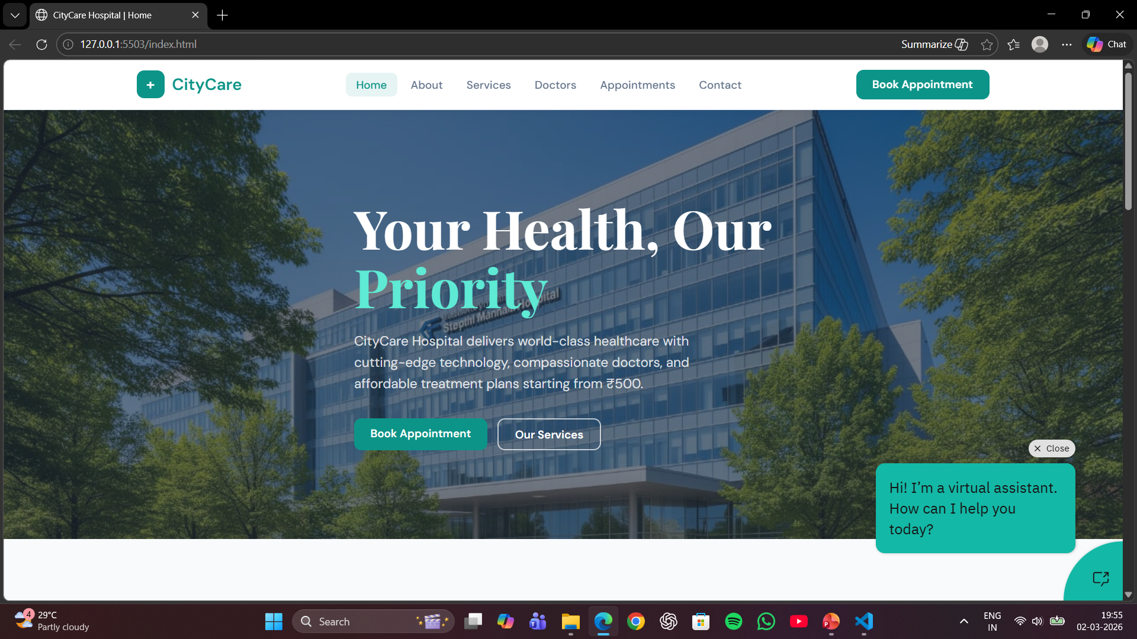
Pages & Functions:
Home – Hospital intro and quick booking access
Services – List of medical departments
Doctors – Doctor profiles and specialization
Appointment – Booking form (main feature)
About Us – Trusted Care, 24/7 Support, Expert Team
Contact – Address, phone, email, timings
Chatbot – Answers queries and guides booking process

Slide 6
Technologies Used
For this project, I used:
Frontend:
HTML
CSS
JavaScript
Chatbot:
IBM watsonx Assistant
Intents
Entities
Dialog Nodes
The chatbot is integrated using an IBM script inside my website.

Slide 7
What is IBM watsonx Assistant Chatbot?
IBM watsonx Assistant is an AI-powered chatbot platform developed by IBM that allows businesses to create intelligent virtual assistants for websites and applications.
It helps businesses to:
Understand user questions using Natural Language Processing (NLP)
Respond automatically with accurate answers
Guide users step-by-step through processes (like booking appointments)
Provide 24/7 support without human involvement
Reduce manual workload and improve customer experience
It works using intents, entities, and dialog flow to create natural and interactive conversations.

Slide 8
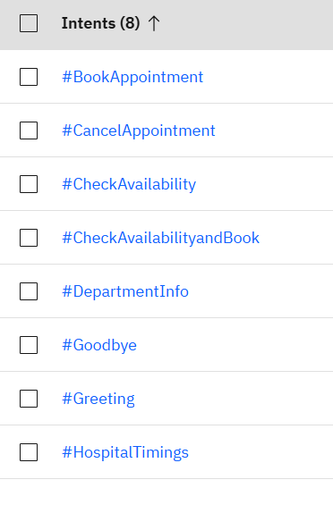
How Chatbot Works
The chatbot works using:
1. Intents
Intent means what the user wants.
For example: If user says: “I want to book appointment” The chatbot understands the booking intent.

Slide 9
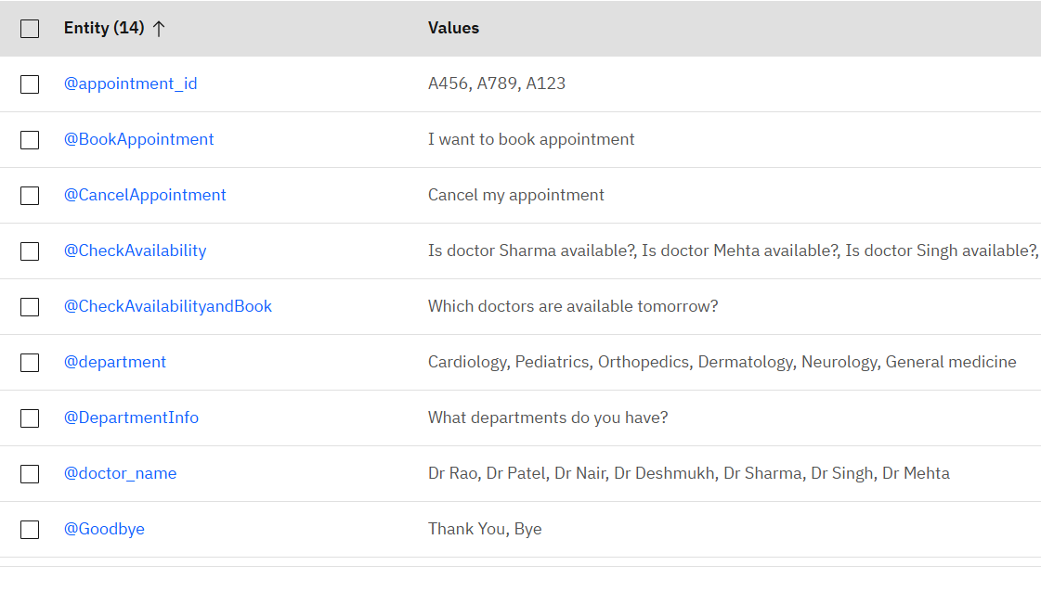
2. Entities
Entity means important keywords.
For example: If user says: “Book cardiology appointment”
The chatbot understands: Department = Cardiology

Slide 10
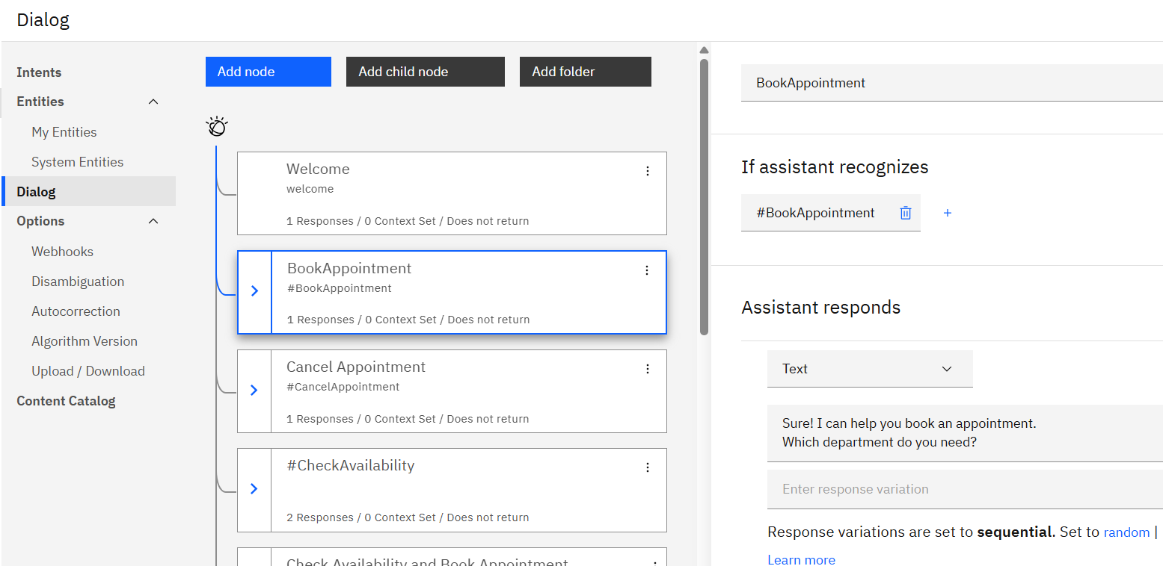
3. Dialog Flow
The chatbot asks questions step-by-step:
Which department?
Which doctor?
Which date?
Then it confirms the booking.
This makes the system interactive and user-friendly.

Slide 11
Future Improvements
In the future, this system can be improved by:
Connecting to a real database
Storing appointment records
Adding payment gateway
Sending SMS or email confirmation
Creating admin dashboard
Adding real-time doctor availability

Slide 12
Conclusion
In conclusion,
This project provides a smart hospital booking system with AI-powered assistant. It:
Saves time
Reduces manual work
Improves patient experience
Provides 24/7 support

Slide 13
Thank You!

